Slide 1






Senior Design Project:
Cognitive Assistance with LiDAR
Localization (C-ALL)
Milestone 4 Demo
Ahmad Shah, Neeti Mistry, Sara Gaber & Sohan Chatterjee
Notes:
TUESDAY MARCH 11
Ahmad: 21-25, 33-35
Neeti: 1-9, 29-32
Sara: 19-20, 24-28
Sohan: 10-18

Slide 2



Introduction
Brief overview and summary of project

Slide 3

Introduction
Objective: Develop an affordable, real-time navigation system for visually impaired individuals
Utilizing LiDAR technology integrated into newer iPhone Pro models for real-time navigation
Technology Stack: LiDAR, Swift, Geographical ARKit, Bluetooth, Raspberry Pi, Mobile Application (iOS), SolidWorks
Key Features:
Real-time obstacle detection and path guidance
Integration between hardware and software
Mapping and navigation on sidewalks rather than roads for improved pedestrian safety
Impact: Enhancing mobility, independence, and accessibility
Started hardware implementation this semester and assembling initial components
Continuing development on codebase, refining obstacle detection and path guidance

Slide 4
List of Requirements
Review list of requirements of your project,
No new changes were made

Slide 5
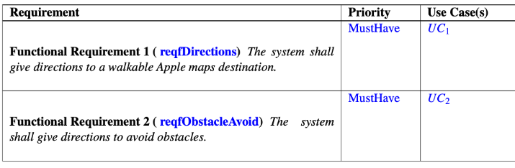
User Requirements

Slide 6
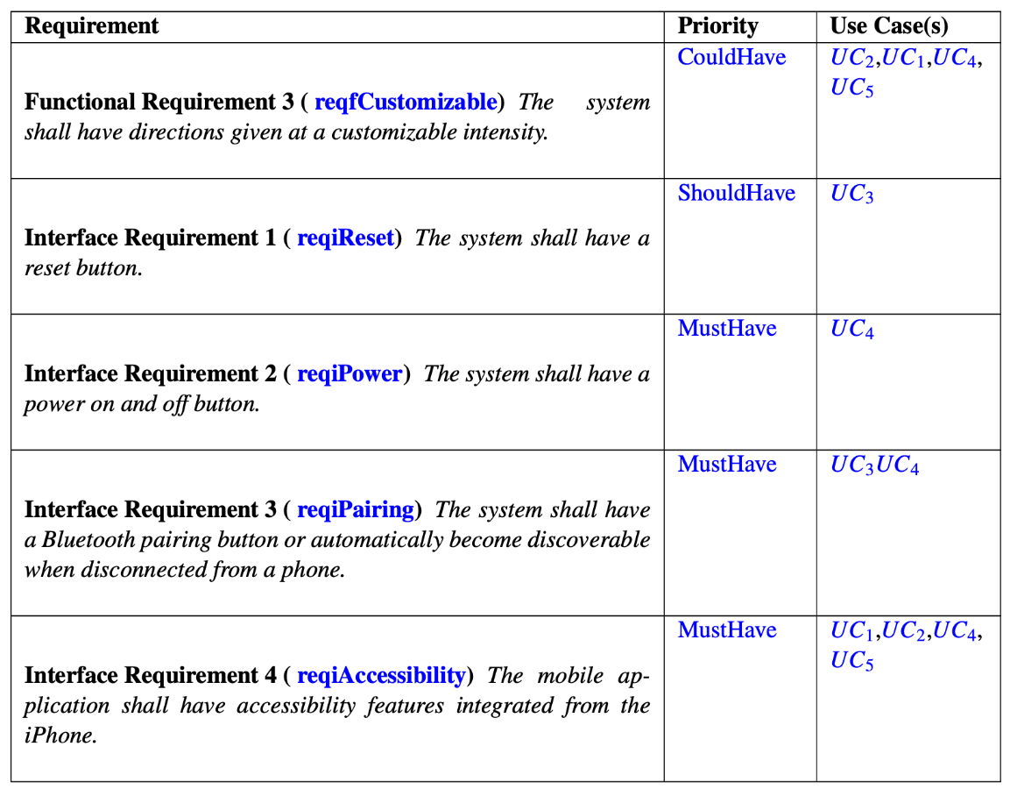
User Requirements

Slide 7
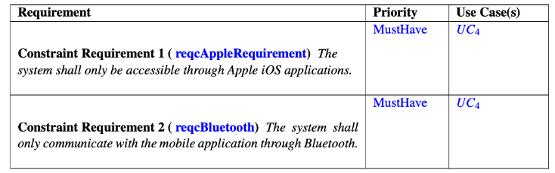
System (Constraints) Requirements

Slide 8
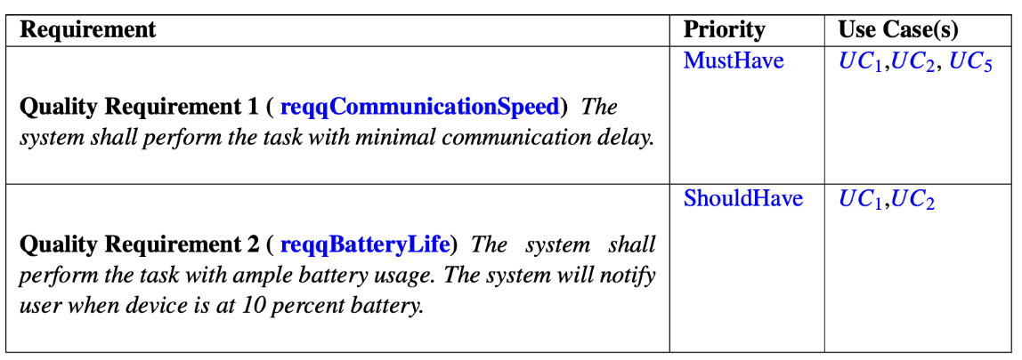
Non-Functional (Quality) Requirements

Slide 9
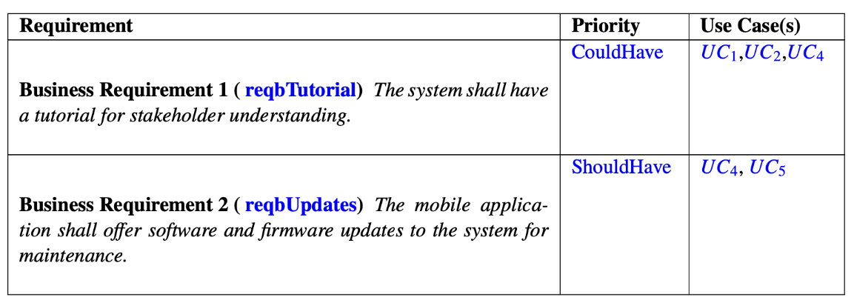
Domain (Business) Requirements

Slide 10
Use Cases
Mapping of requirements to use cases

Slide 11
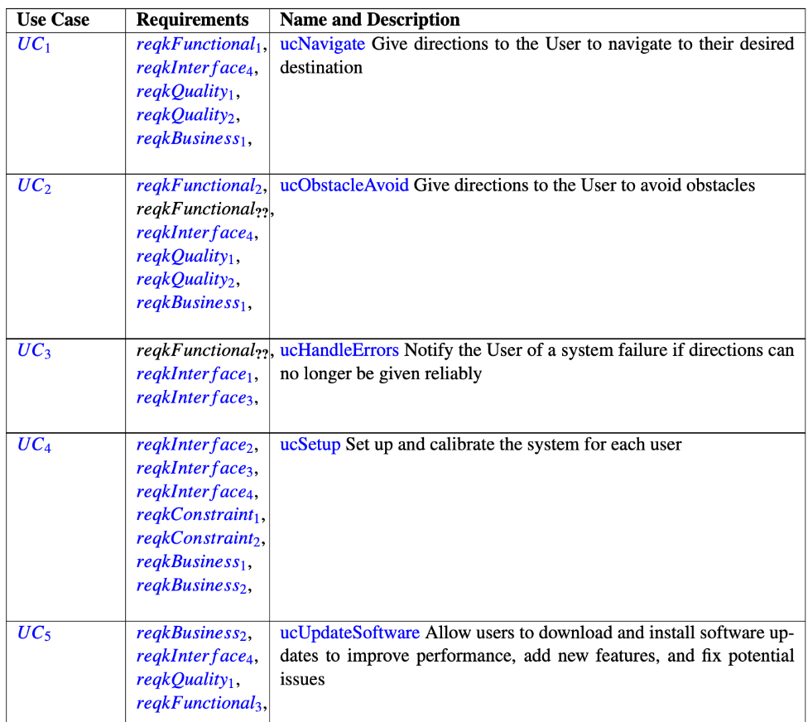
Table of Use Cases

Slide 12
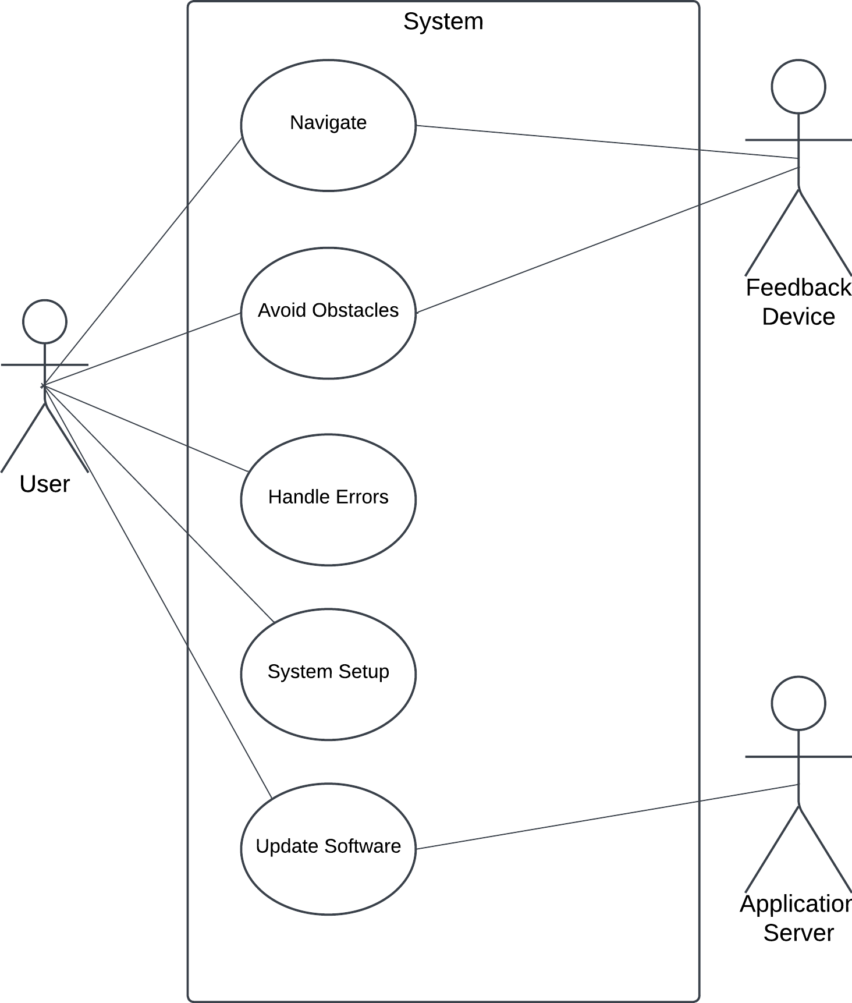
Use Case Diagram

Slide 13
New Use Case and Corresponding Activity Diagram
New use case for making software updates and corresponding activity diagram added

Slide 14
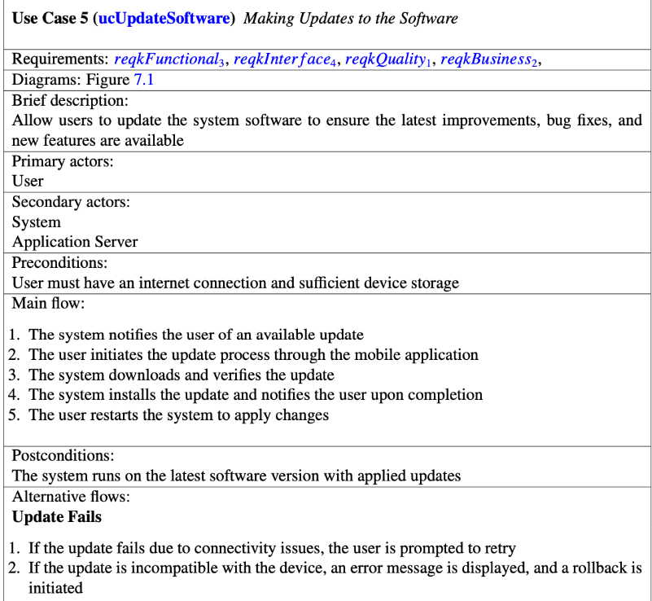
Use Case

Slide 15
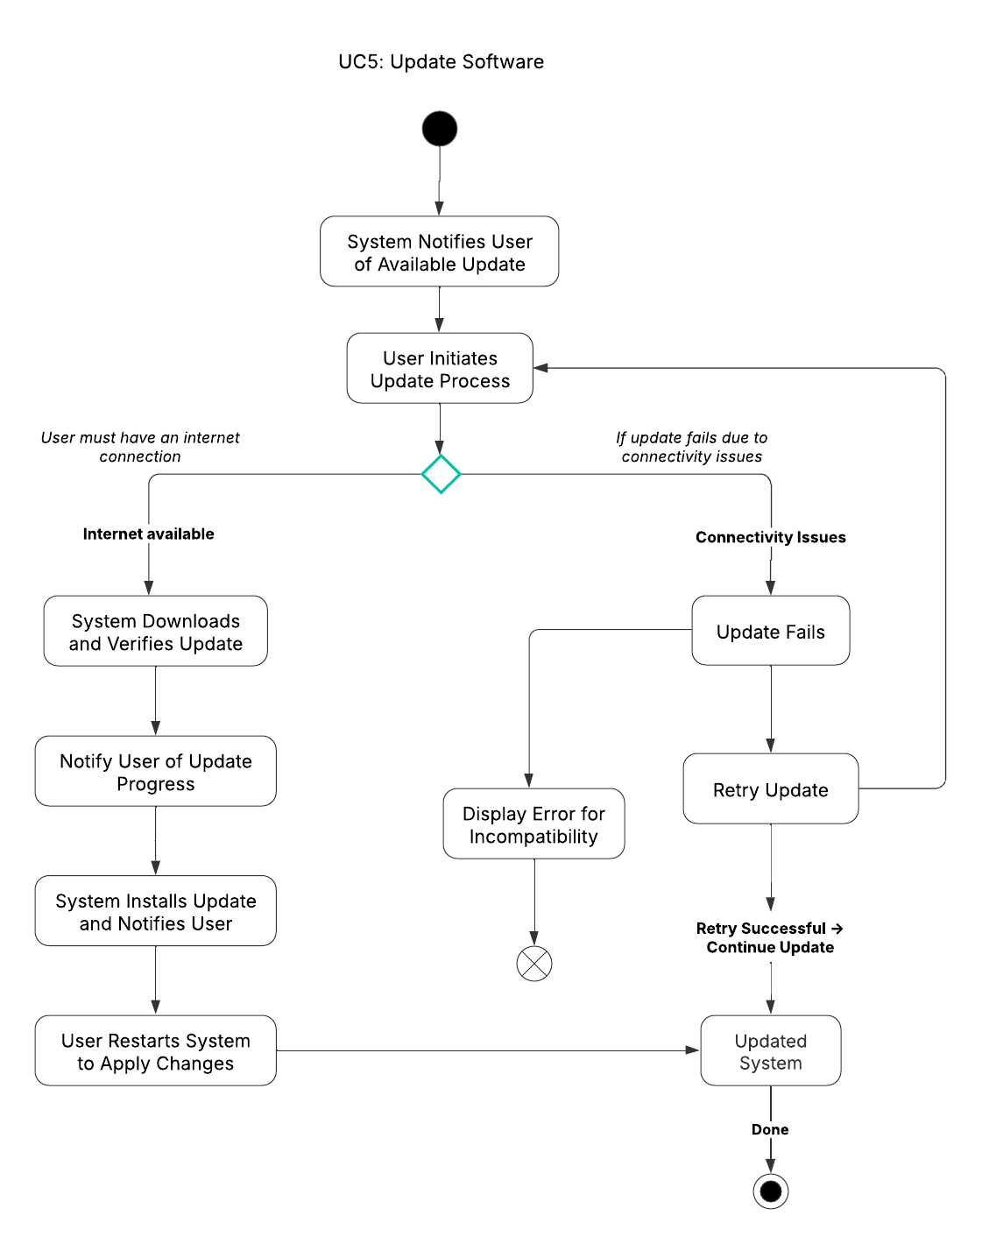
Activity Diagram

Slide 16
Class Diagram and CRC Cards
Review of class diagram and CRC Cards

Slide 17
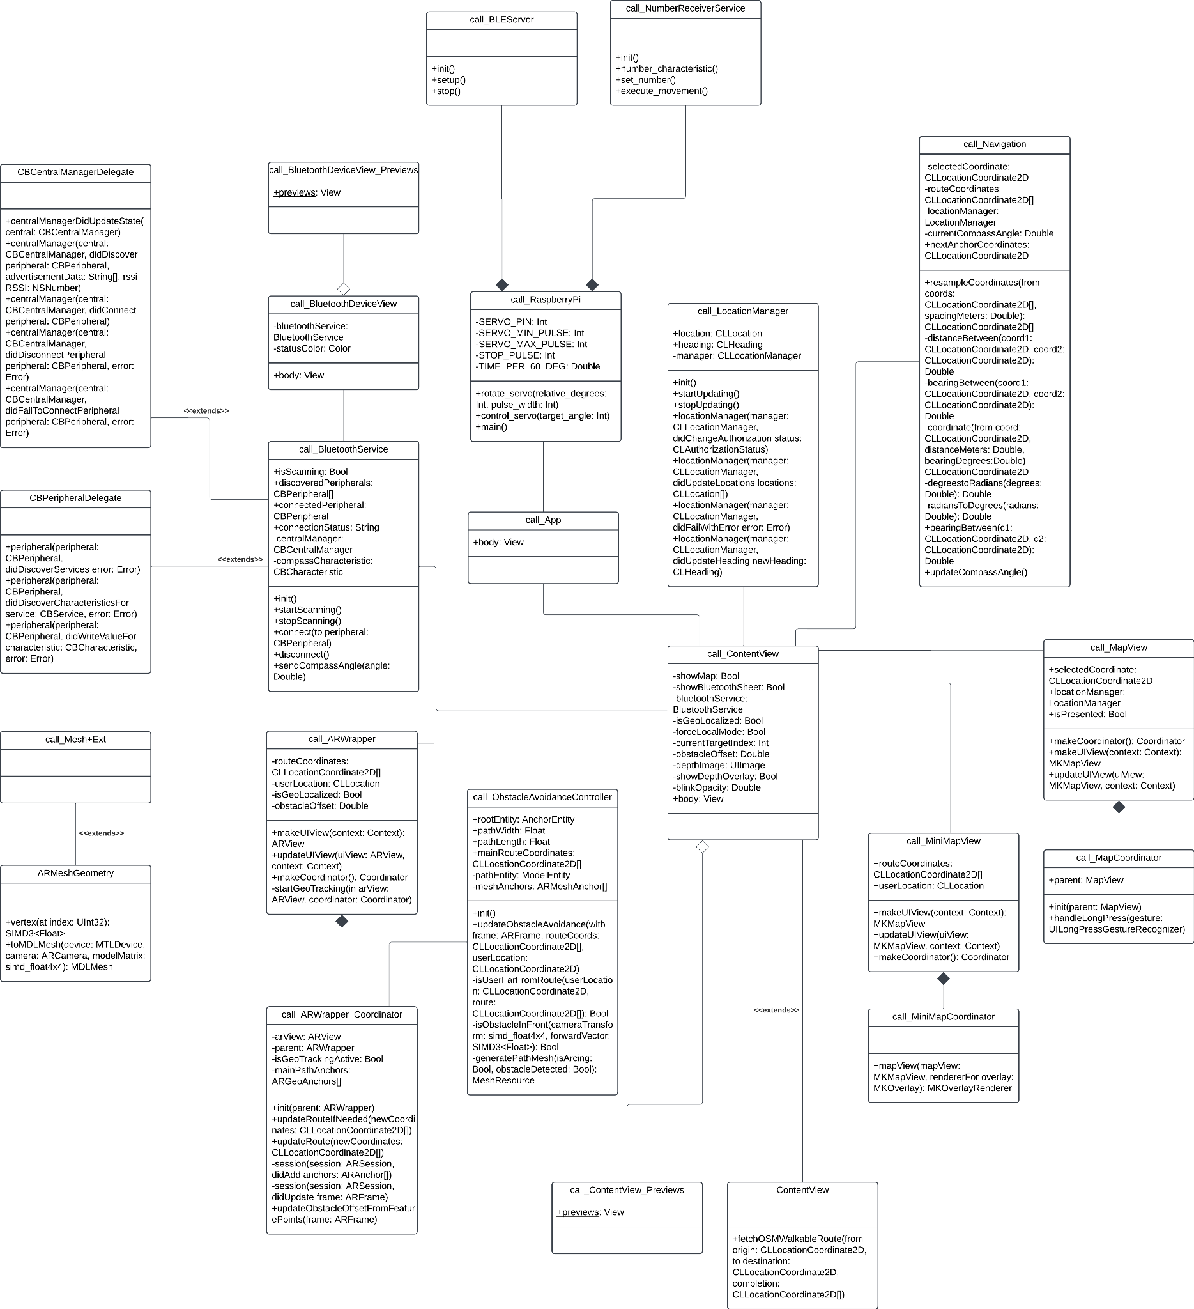
Class Diagram
Noteworthy Changes
New Classes
call_BluetoothService
call_BLEServer
call_NumberReceiverService
call_ObstacleAvoidanceController
Altered Classes
call_ARWrapper
call_RaspberryPi
Removed Classes
call_MotorControl

Slide 18
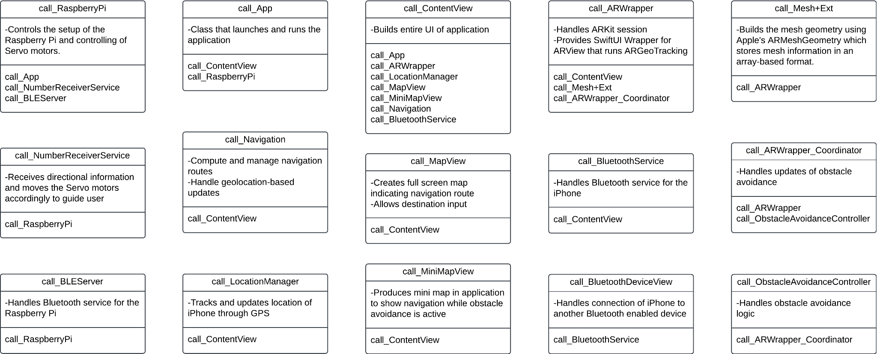
CRC Cards

Slide 19
UML Diagram Updates
Updates to any UML diagrams that were made

Slide 20
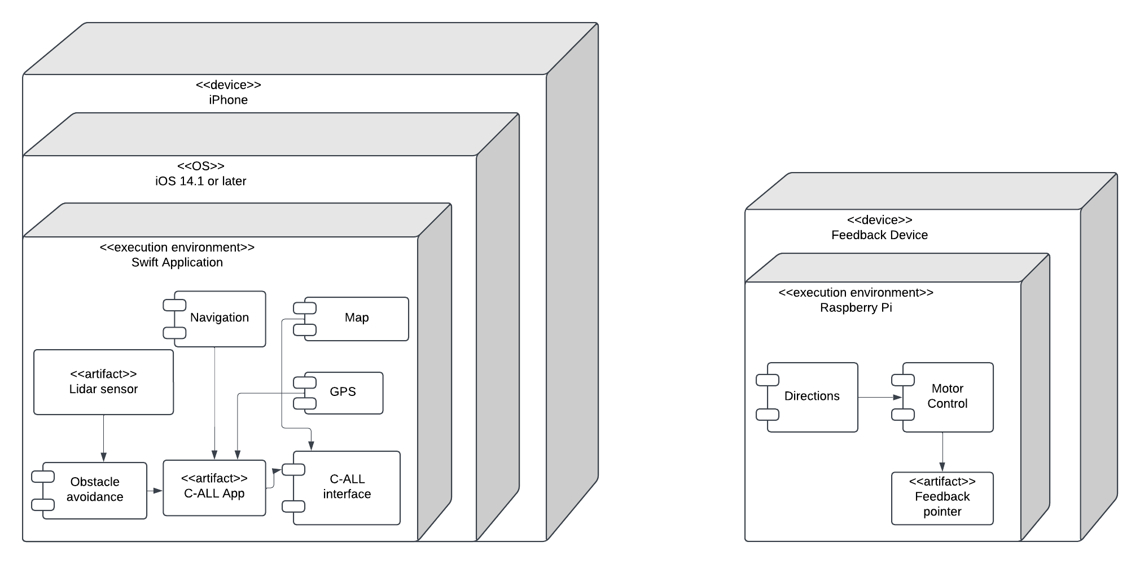
Deployment Architecture Diagram

Slide 21
Working Prototype Demos
Current status of the project implementation and testing

Slide 22
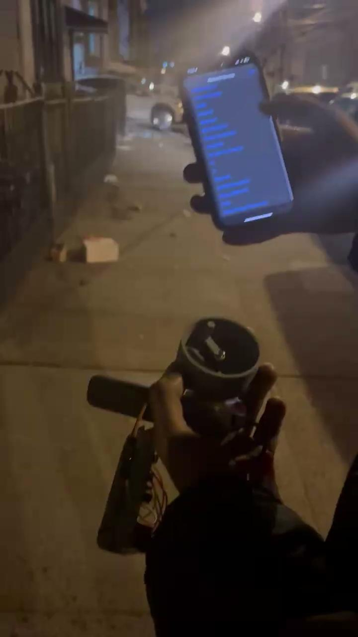
Working Prototype Demos

Slide 23
Versioning Logic
Show depots of generated versions

Slide 24
Versioning Logic
Prerequisites: Apple Developer Membership
General Steps:
Upload Build on TestFlight
Add internal testers
Obtain Feedback
Publish on App Store
Devops: TestFlight has its own CI/CD system

Slide 25
Versioning Logic
Upload Build to TestFlight
Upload to App Store Connect (Distribution Files)
Adding Test Details
Adding Test Information
Distribution Files Will Be Tracked Using GitHub
Our distribution will be versioned as follows:
Major.Minor.Change (Github Hash)
Major (X.0.0): Significant changes that may introduce breaking changes
Minor (X.Y.0): New features that are backward-compatible
Change (X.Y.Z): Small patches, Bug Fixes

Slide 26
Issue Tracking System
Tracking issues and tasks on Jira

Slide 27
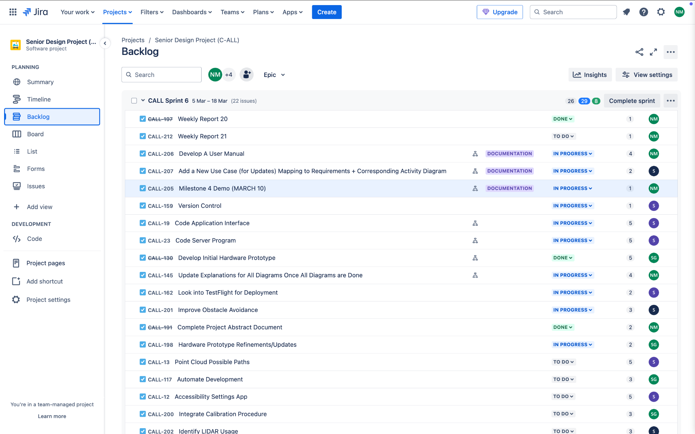
Issue Tracking System (Jira)

Slide 28
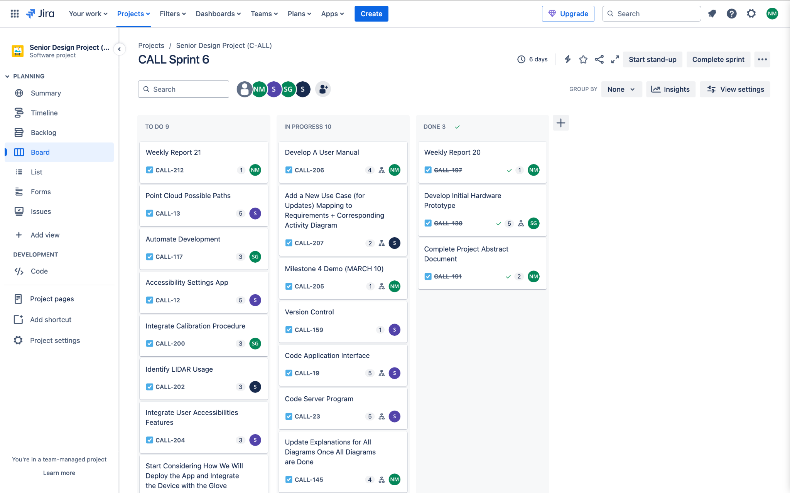
Issue Tracking System (Jira)

Slide 29
User Manual
Developing a comprehensive user manual as additional documentation for our device

Slide 30
User Manual
A User Manual was created to:
Guide Users – Provide clear instructions on setting up and using the C-ALL system effectively
Enhance User Experience – Reduce confusion and streamline system interactions
Support Troubleshooting – Offer solutions for common issues, ensuring smooth operation
Enable System Updates – Educate users on maintaining and updating the system for optimal performance
Setup Instructions
Power on the device & connect via Bluetooth
Follow on-screen steps to calibrate
Software Updates
System notifies user of updates
Requires internet & restart after installation
Maintenance & Troubleshooting
Reconnect Bluetooth if disconnected
Recalibrate for accurate feedback
Restart system if issues persist

Slide 31
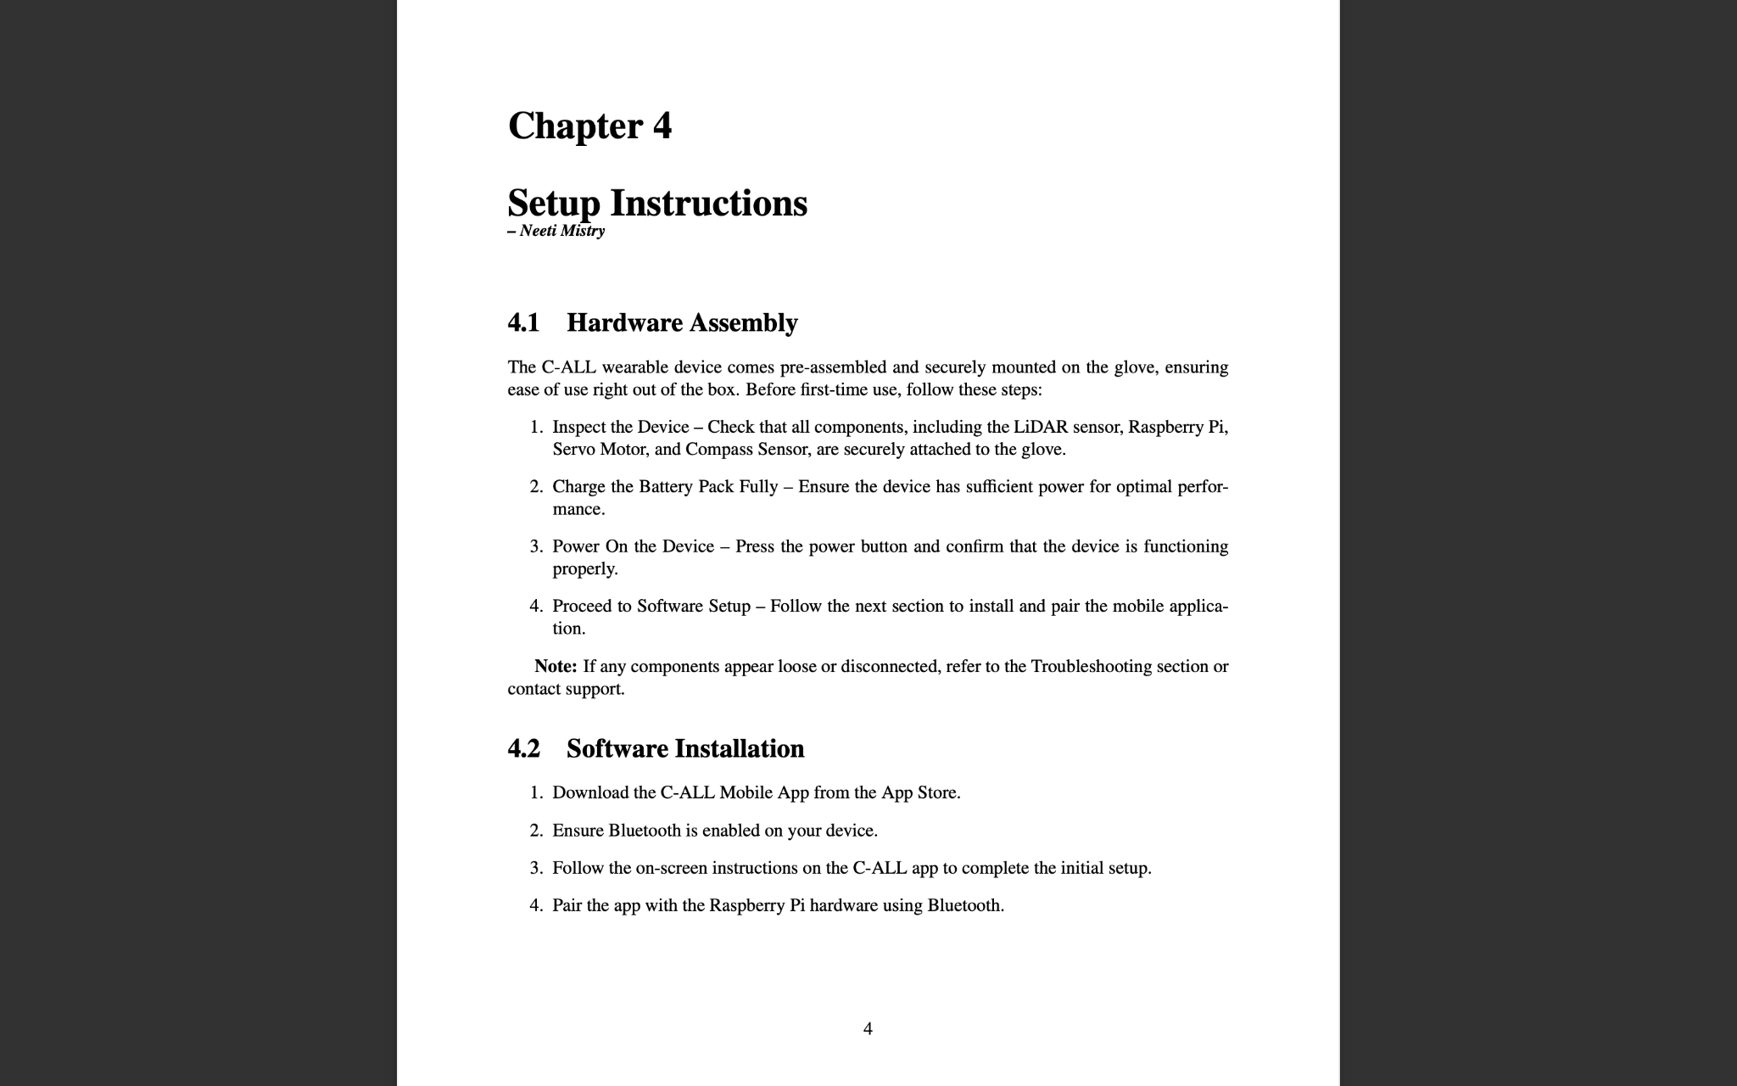
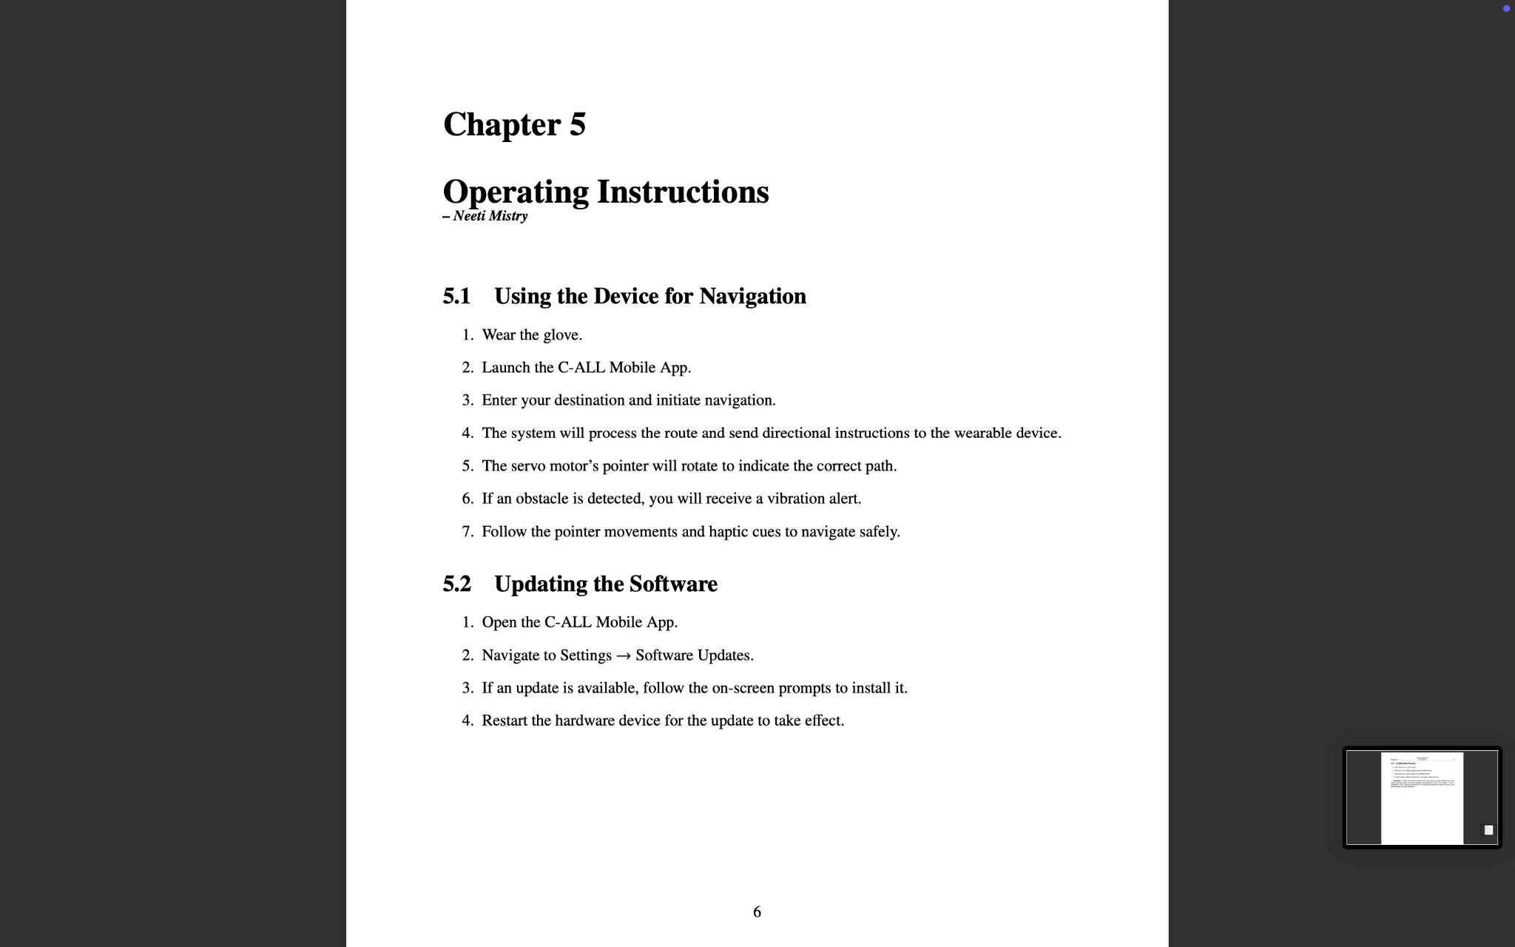
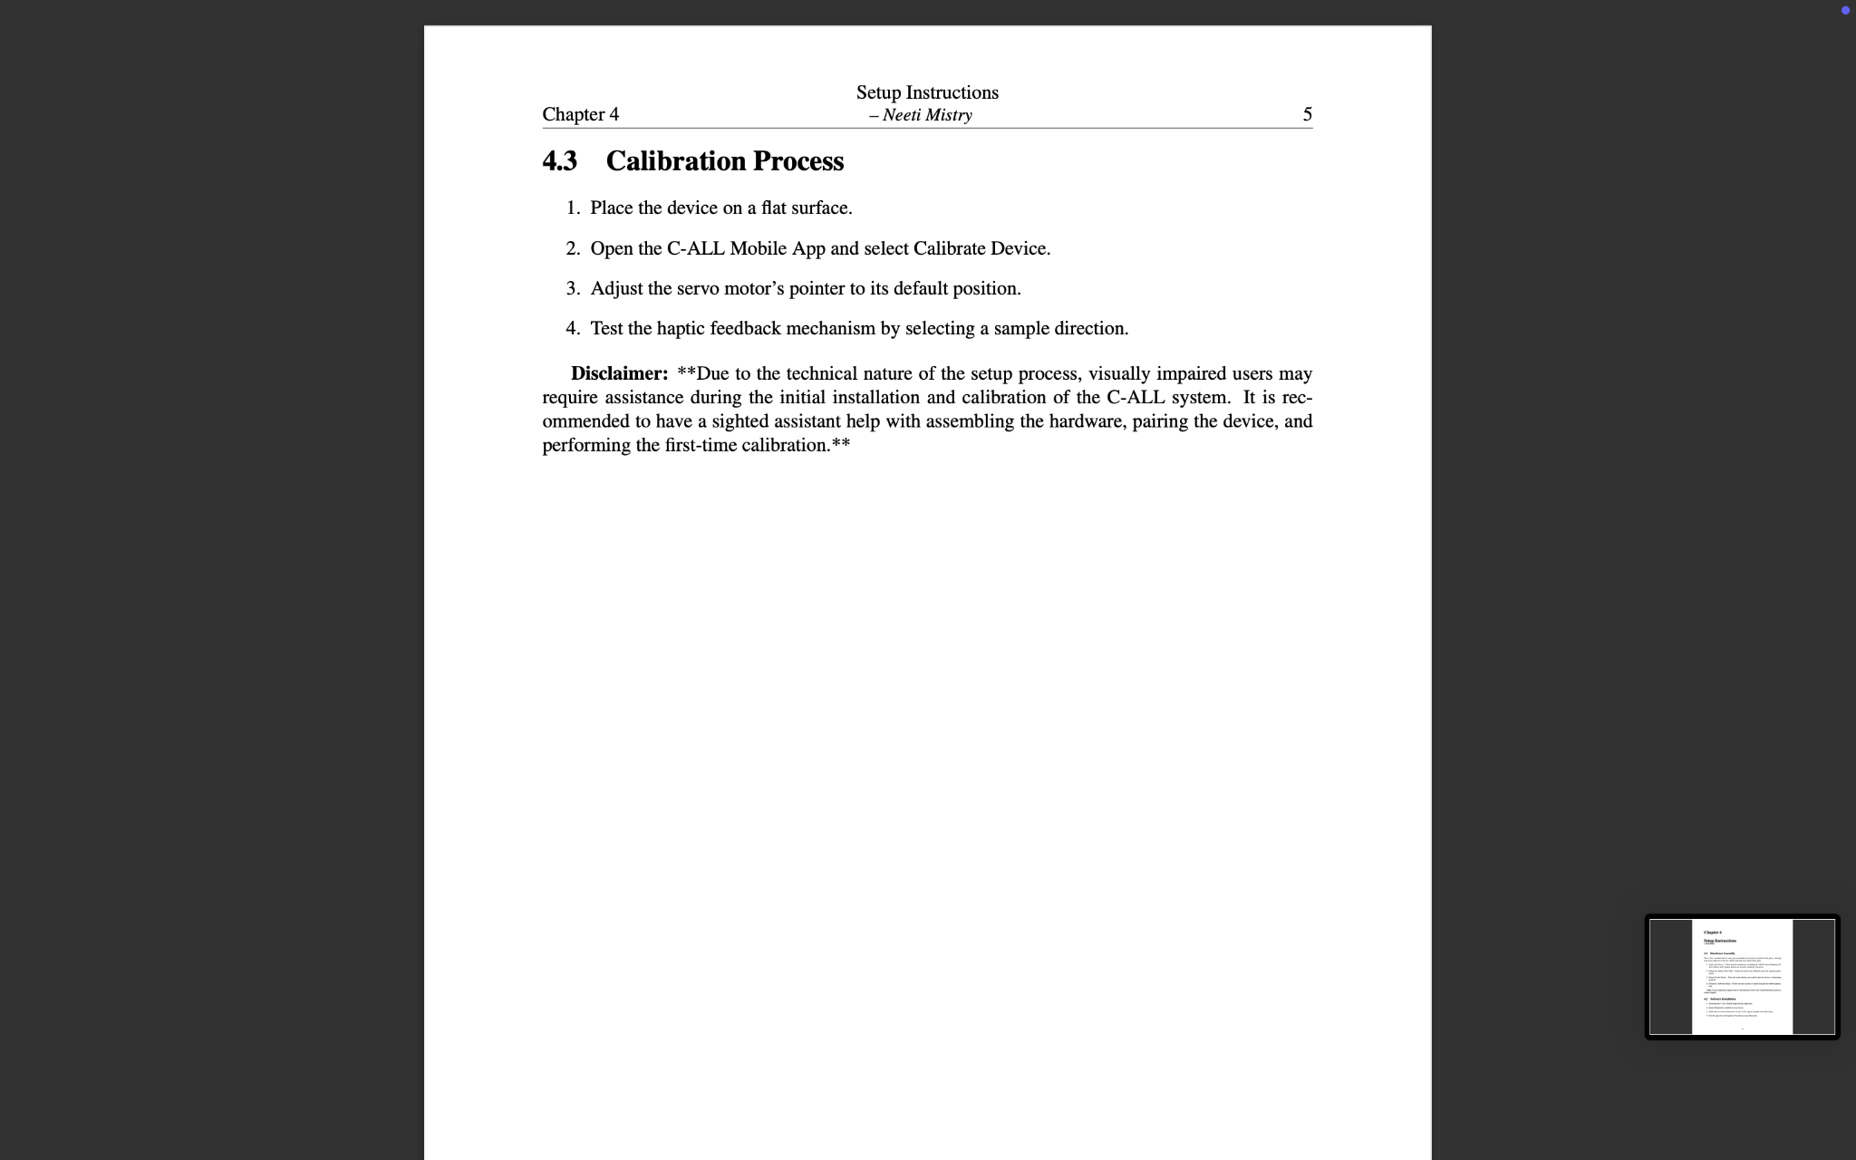
User Manual

Slide 32
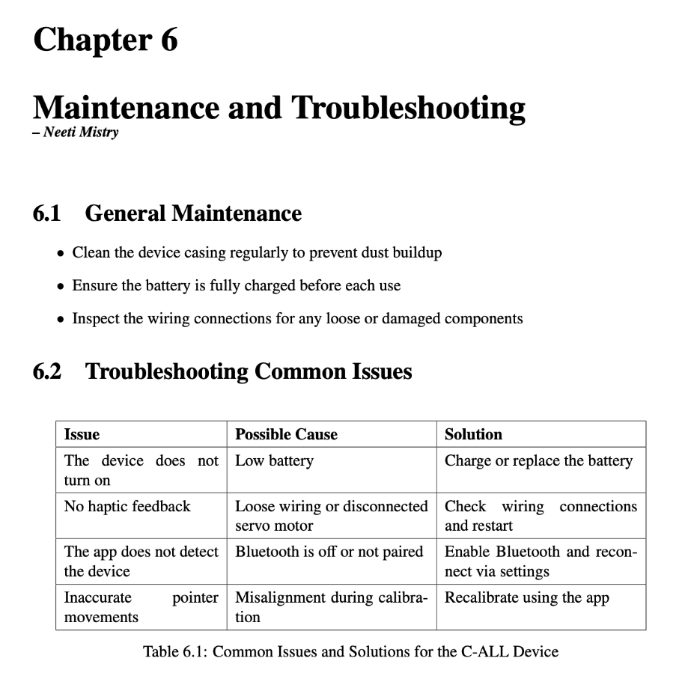
User Manual

Slide 33
Next Steps
What the Team Plans to Focus on Next

Slide 34
Next Steps
Conduct Usability Testing
Gather feedback from visually impaired users to refine functionality and accessibility
Finish Implementing Versioning
Ensure smooth software updates and maintain compatibility across future iterations
Complete User Manual Documentation
Finalize instructions for set-up, operation, and troubleshooting
Refinements
Improve hardware integration, fine-tune LiDAR processing, and enhance system responsiveness

Slide 35





Thank you!
Any Questions?

